Slide 1
DnD Character Creator
By : Jason Spencer, Dheeraj Singavarapu, and JJ Javier

Slide 2
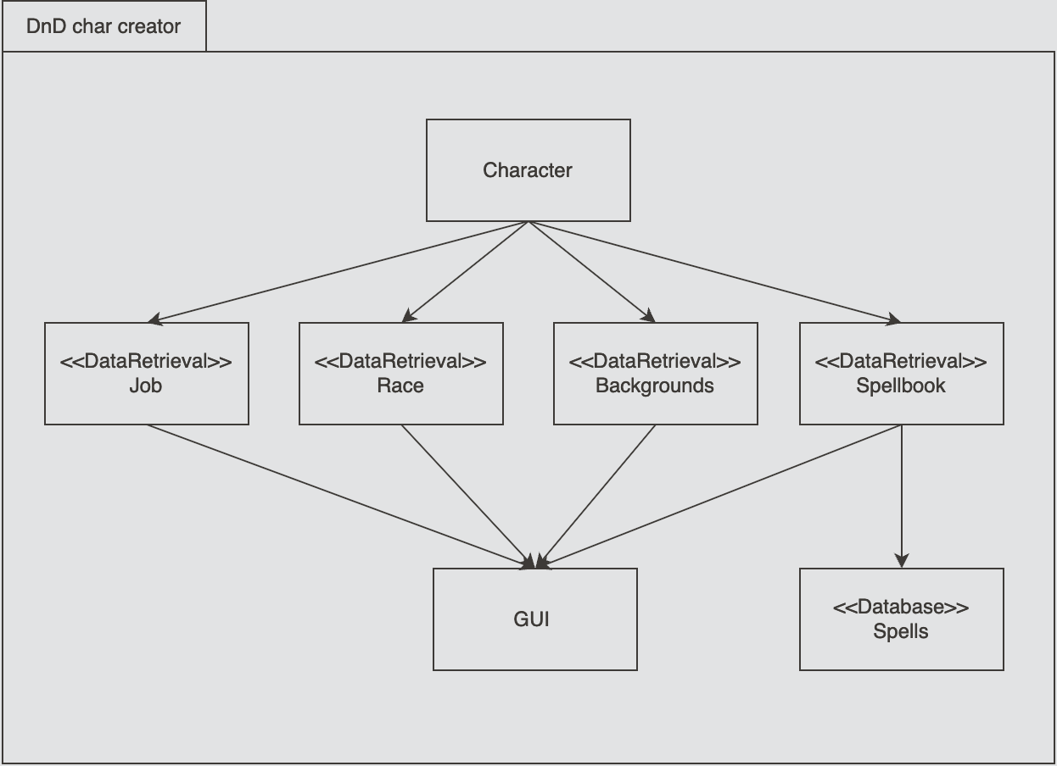
System Design(s) Before
Decentralized Logic
Convenience over design
Multiple responsibility classes
Package Diagram

Slide 3
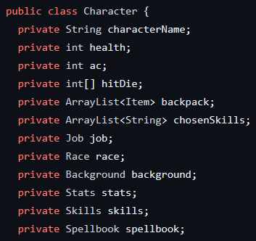
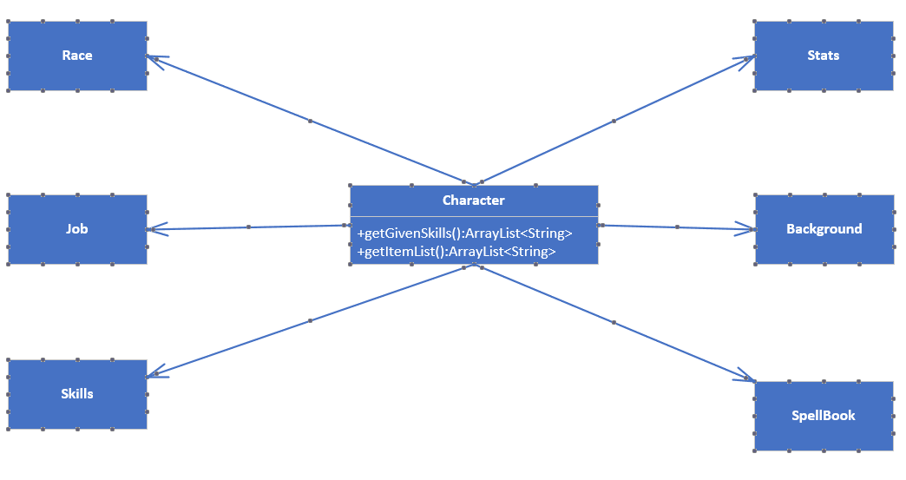
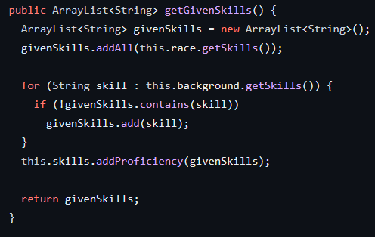
Mediator Pattern

Slide 4
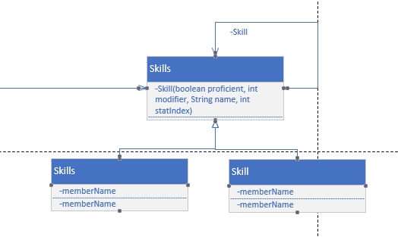
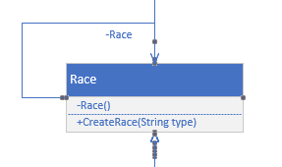
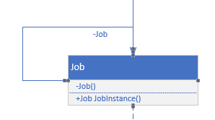
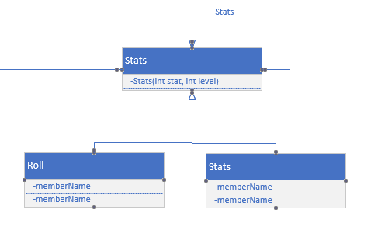
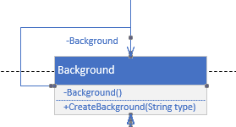
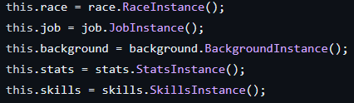
Singleton Pattern

Slide 5
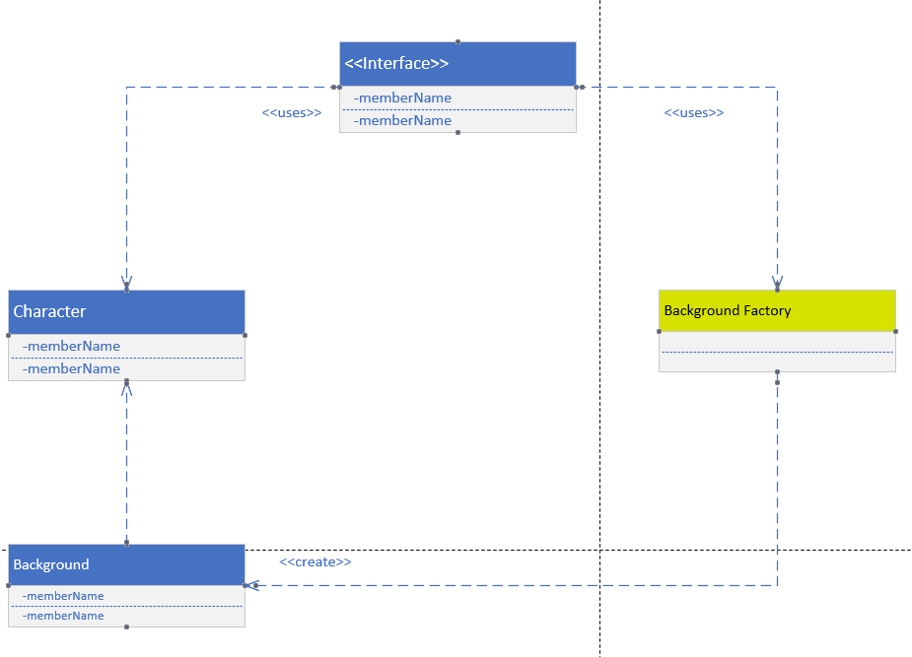
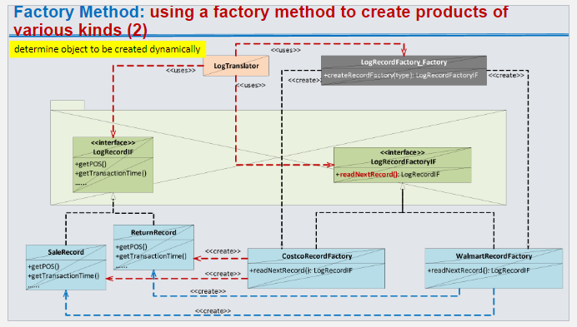
Factory Design Pattern
Though different in looks, it is being used the same
We don't use the use of multiple interfaces, but it is indirectly being used through a different class
User won’t see the Factory (agnostic)
Will use type::String to figure out which to create

Slide 6
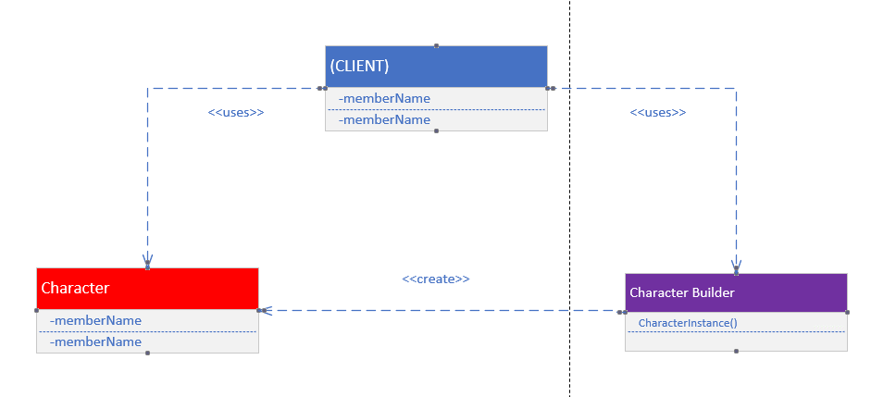
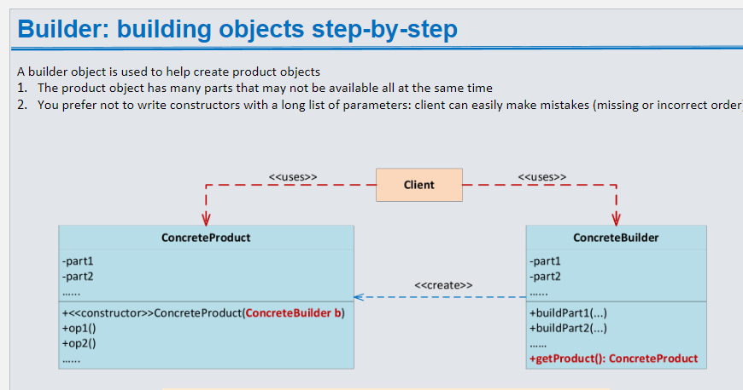
Builder Design Pattern
Notes:
The point of the builder design pattern is to take the user input and then create an instance of a character. This input is passed as a string to the factory design pattern. The factory design pattern then creates a part of a character being either a job, race, or background and then it passes that back to the builder as a instance of a specific character trait. Once the character variable is done being created that variable is passed to the character class which instantiates it as a completed version of the character being made.

Slide 7
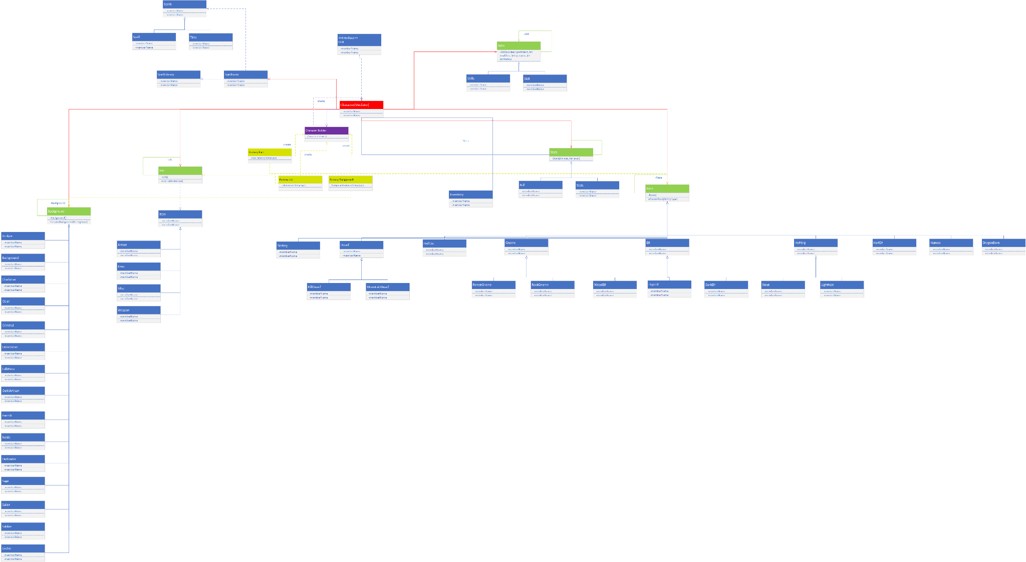
System Design(s) After
Notes:
The system before had methods of creating characters spread throughout the entire system and was somewhat of a mess. However after implementing the builder pattern we were able to move the logic for creating a character into a single area. In the design before the character class hosted all of the creation for a character however after implementing the factory design pattern we moved some specific character traits into their own factories. These factories create parts of the character in a separate area compared to how before it was all done in one area. This made things spread out more and more understandable.

Slide 8

System Demonstration

Slide 9
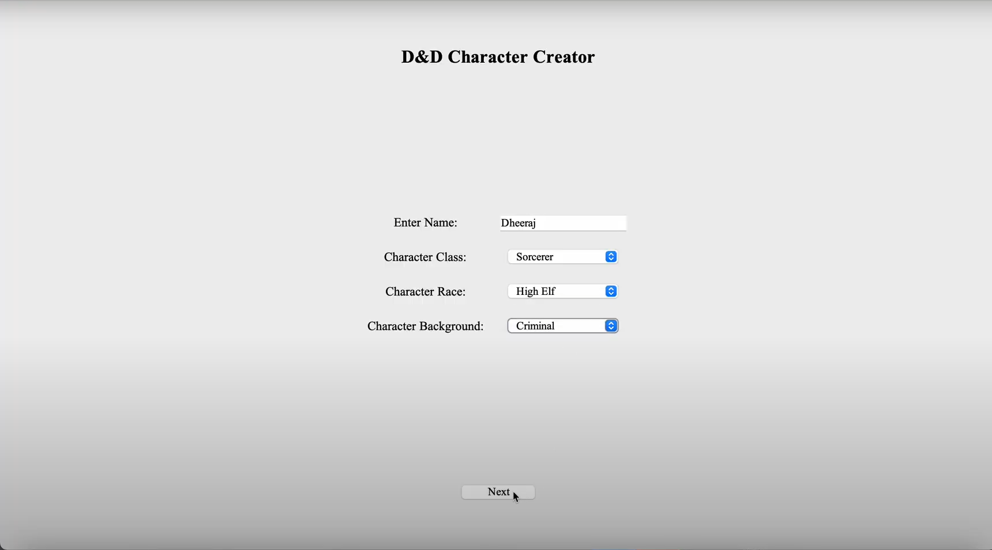

Slide 10
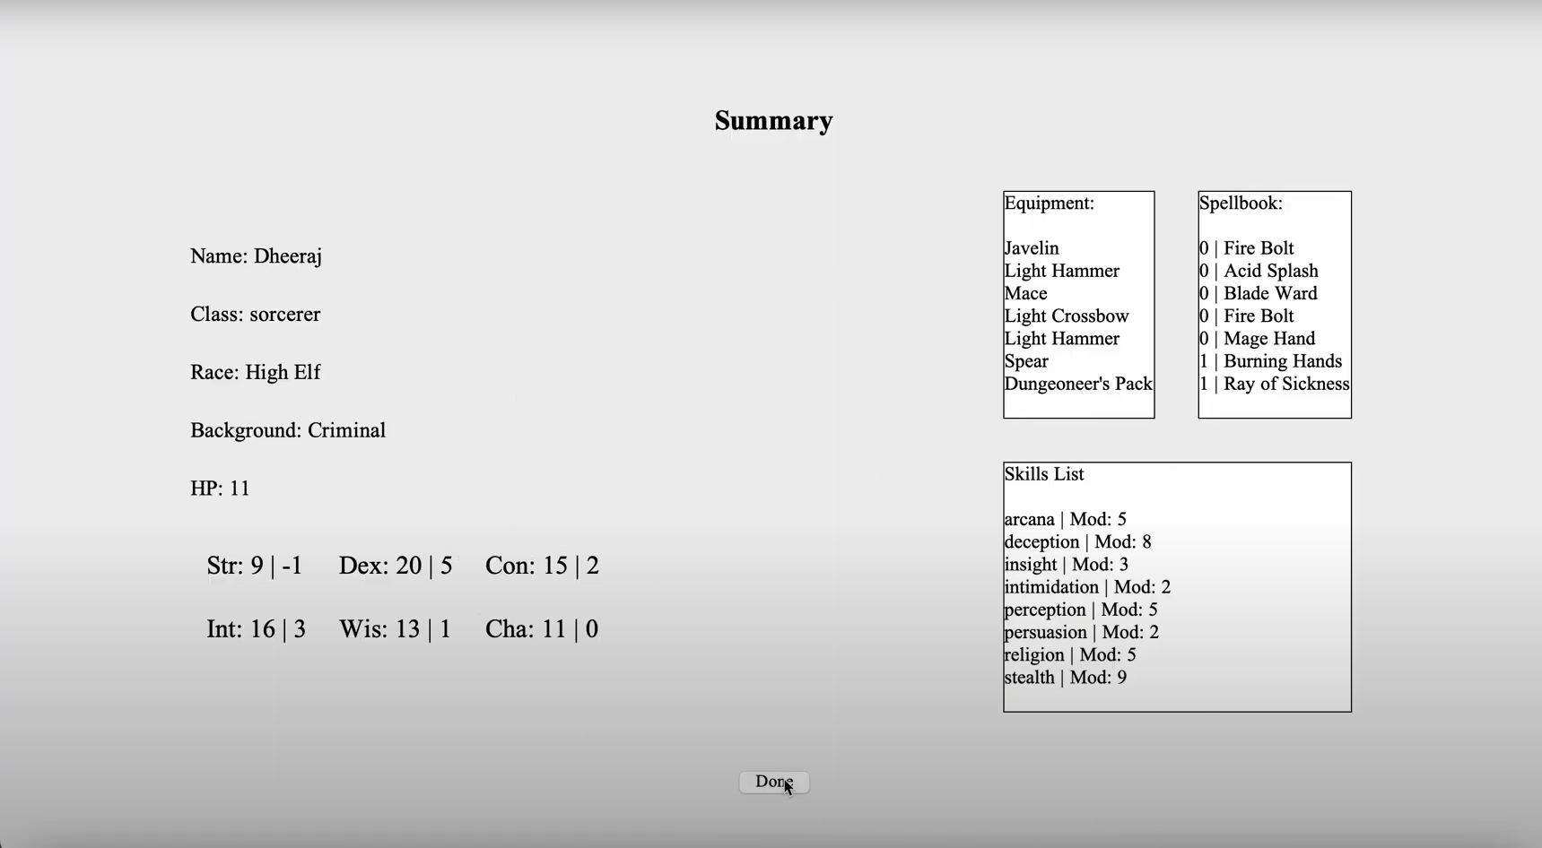

Slide 11


Progress Update
Notes:
Thus far we were able to implement 3 out the 4 design patterns we intend to implement. We have yet to implement the builder pattern but plan on doing that as soon as possible. We were able to create UML’s for the entire system as well as for the new design patterns being implemented. So far the system is responding well to the new design patterns being implemented and they prove to be a good addition to the system.

Slide 12
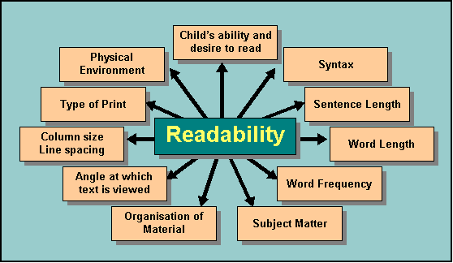

Lessons Learned
Notes:
Through this project and the implementation of design patterns into a java system I think we learned how useful design patterns actually are. Although the system was working before allowing for the implementation of these design patterns made for a much more efficient system in the end. It made things much less cluttered compared to the previous design which in turn increased the readability of the code. It also really helps with understanding the relations between each of the classes and the methods as the design patterns make those relations very evident and easy to discern.

